Slide 1


Seyed Mohammad Jafari
PhD Candidate in Management
Graduate School of Management (GSM)
University of Putra Malaysia (UPM) jafari76@gmail.com
Research Tools
A Thesis Writing Approach
May 25, 2011

Slide 2
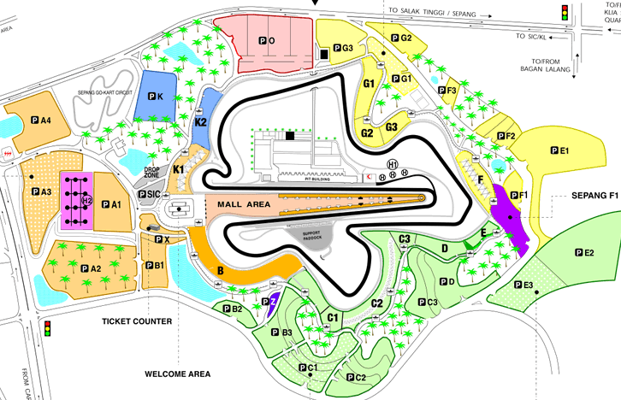
What is this?

Slide 3
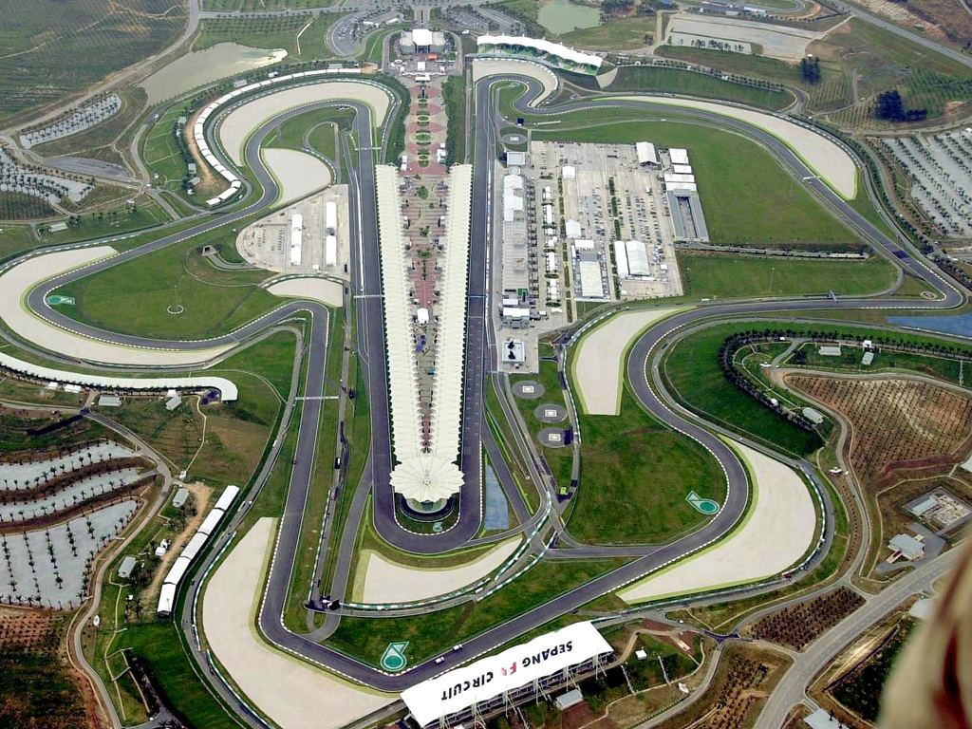
Thesis writing is a journey at circuit

Slide 4
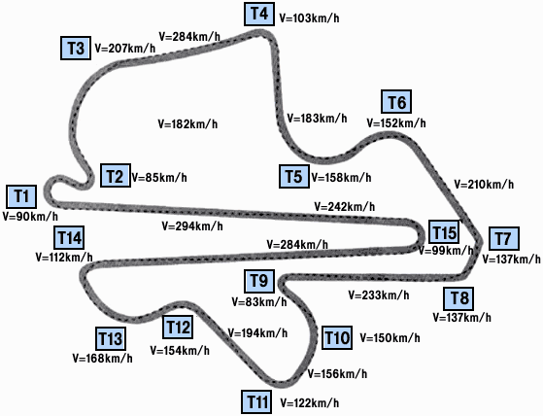
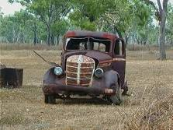
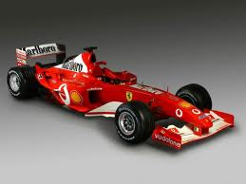
Equip yourself

✓

Slide 5
Content
Research tools help research student to spend less time on search and more time on
discovery
Content of Part I:
Finding proper keywords
Initial appraisal of the topic and getting more familiar with it
Conducting a systematic literature review
Evaluating a paper/journal quality
Keeping up-to-date (Alert system)

Slide 6
Content
Content of Part II:
Review of “Research Tools I (Part I)”
Mind-mapping
Searching inside the articles
Organizing the references (Reference management)
How to avoid plagiarism
Plagiarism checking tools

Slide 7
Thesis writing flow using research tools
Selecting a topic
Finding related Keywords
Initial evaluation of the topic
Selecting core papers on the topic
Keeping up to date
Systematic literature review
Indexing the sources
Mind-Mapping
Avoid Plagiarism
Cite while you write
Reference Management

Slide 8
Selecting a topic
Researcher’s interest
Emerging Research Fronts
Essential Science Indicator (ESI)
Fast Moving Fronts
Availability of Fund
Top Topics
Source of a topic
Availability of instrument
Exp: www.esi-topics.com
Available Supervisors
Continuing MSc thesis

Slide 9

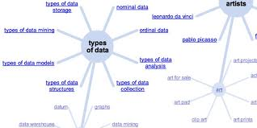
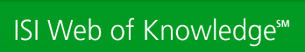
Finding proper keywords
Google AdWords
Google Wonder Wheel
KeyWords Plus

Slide 10
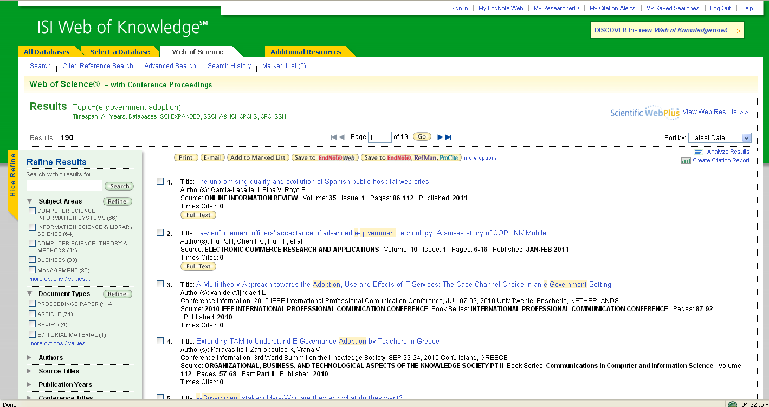
Initial appraisal of your topic and getting more familiar with it

Slide 11
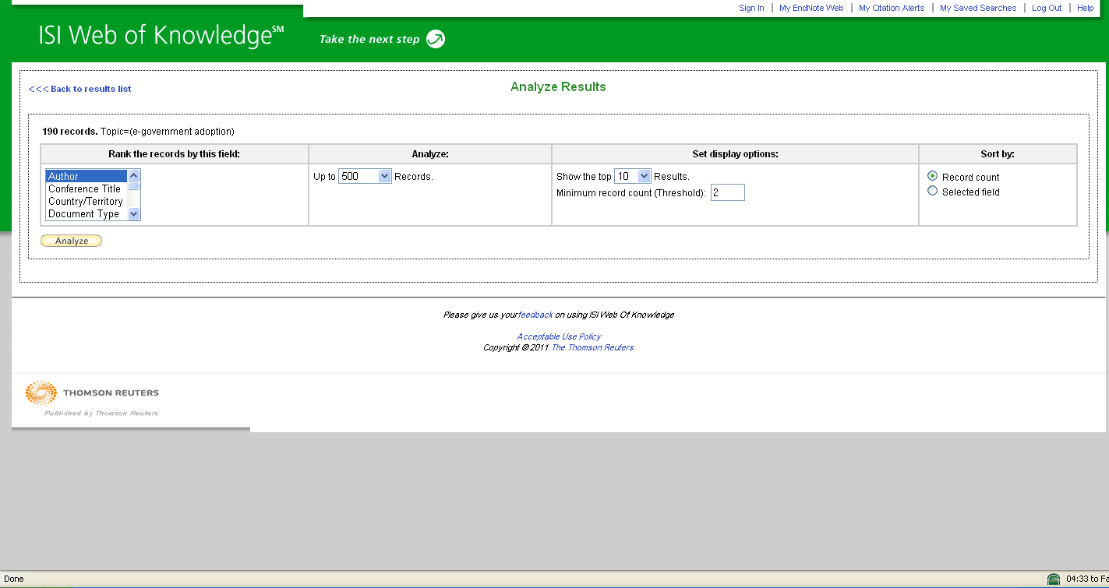
Initial appraisal of your topic and getting more familiar with it

Slide 12
Evaluating a paper/journal quality
1- Initial Appraisal:
    Author
    Journal (ISI vs. non-ISI)
    Publisher (well known vs. unknown)
    Date of Publication (most recent one)
    Edition or Revision (make sure you found the latest version)
2- Content Analysis:
    Intended Audience
    Objective Reasoning
    Coverage
    Writing Style
    Evaluative Reviews
h-index
Impact Factor
Exp: AutoSummary Tools

Slide 13
h-index
A scientist has index h if h of [his/her] Np papers have at least h citations each, and the other (Np − h) papers have at most h citations each (Jorge E. Hirsch)

Slide 14
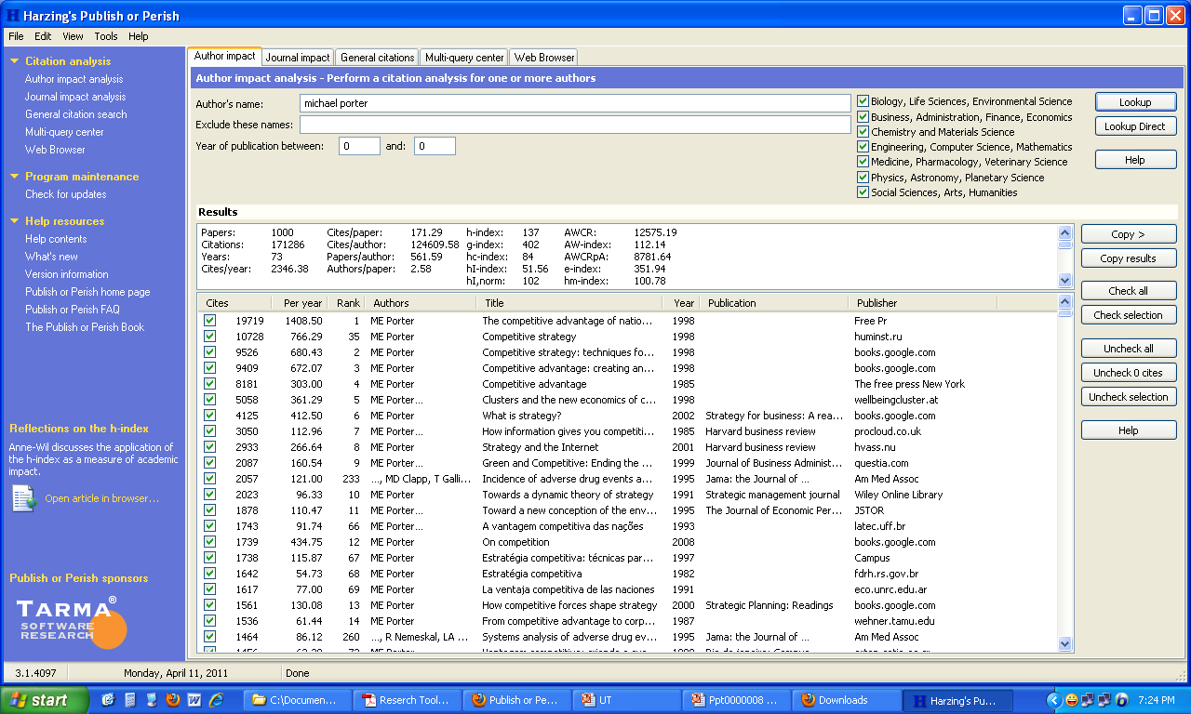
Publish or Perish

Slide 15
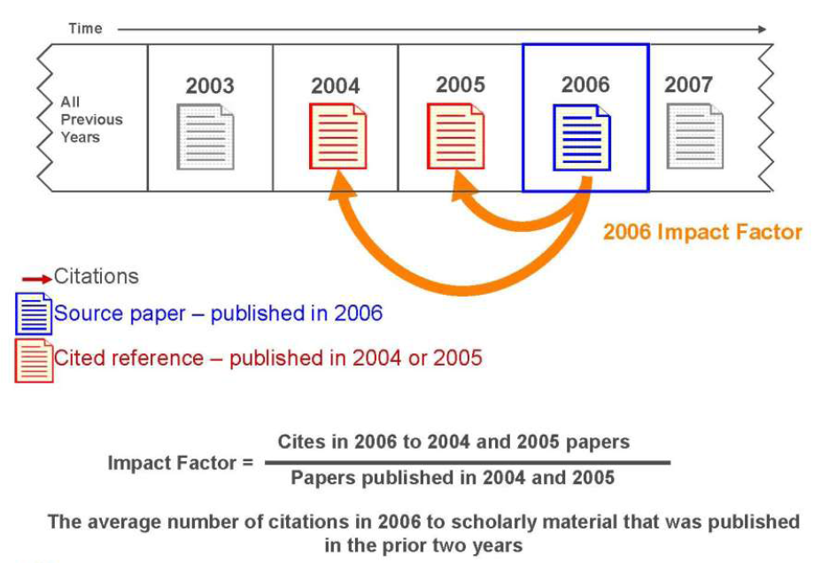
Impact Factor

Slide 16
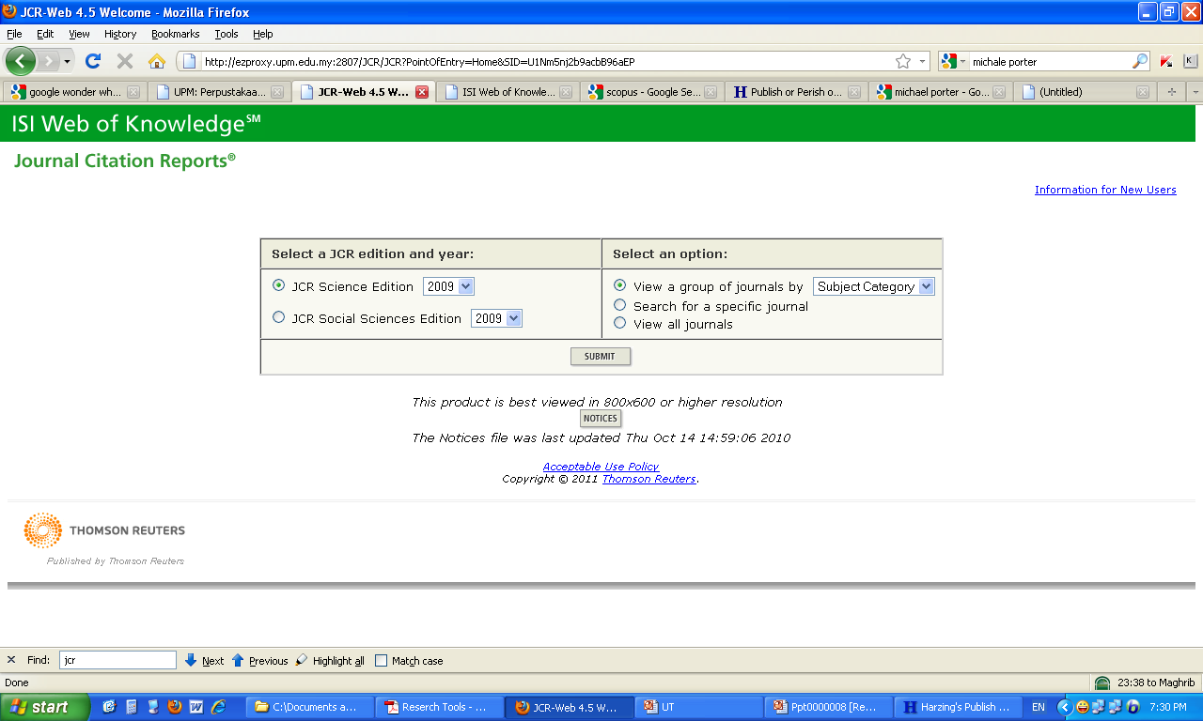
Journal Citation Reports (JCR)

Slide 17
Conducting ‏a systematic literature review
Review Articles
(Meta-analysis)
Go Backward
Systematic Literature Review
Go Forward
Webster, J., & Watson, R. (2002). Analyzing the past to prepare for the future: Writing a literature review. MIS Quarterly, 26(2), 13-23.
Related Articles

Slide 18
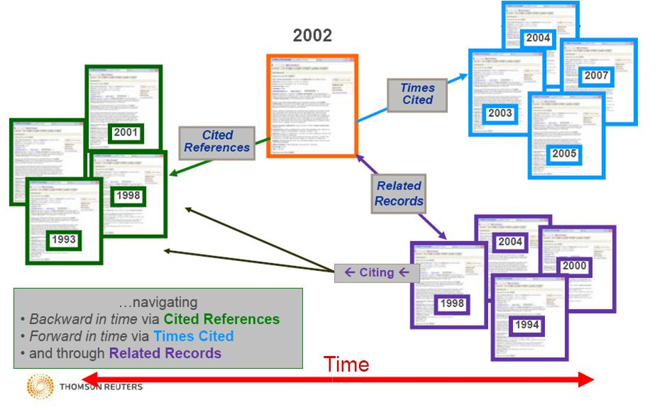
Conducting ‏a systematic literature review

Slide 19



Conducting ‏a systematic literature review
Search Engines
Advance Search/
Analyze Results

Slide 20









Keeping up-to-date (Alert system)
Activate databases
alert systems
Others Publishers

Slide 21



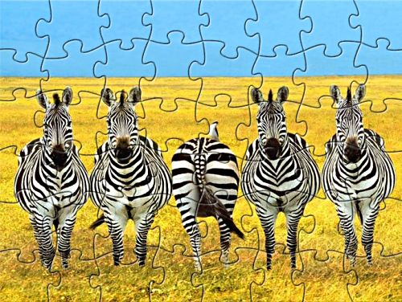
Research as a Puzzle

✓

Slide 22
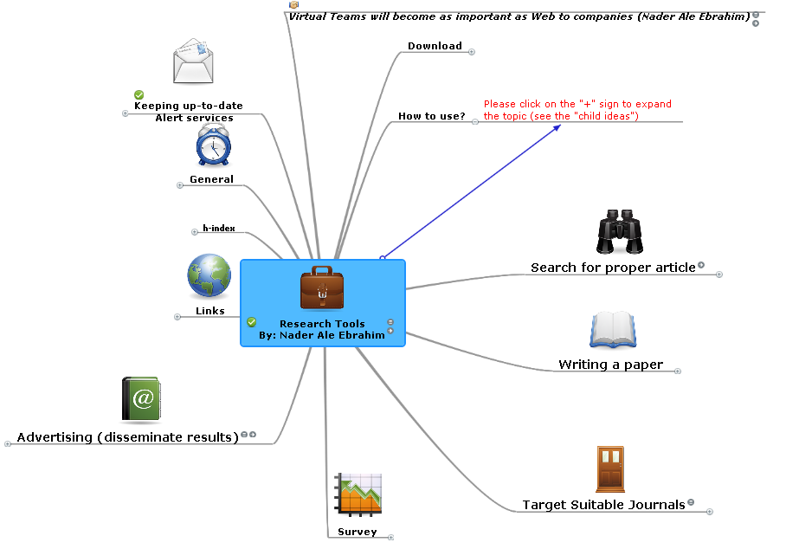
Mind-Mapping

Slide 23
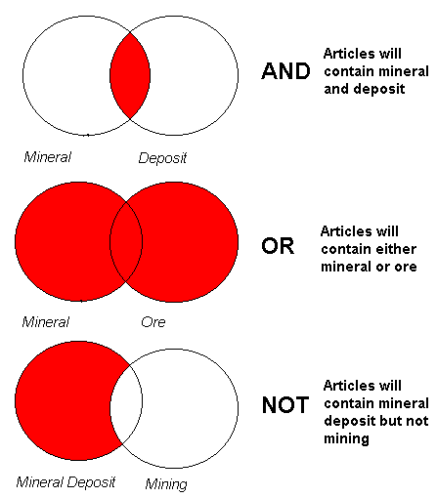
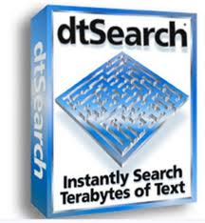
Searching inside the articles
Smartly keywords selection
Desktop Search
Boolean search techniques

Slide 24
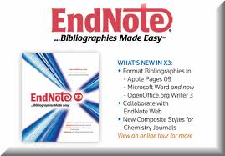

Organizing the references (Reference management)
References Management
Import into
EndNote
Save time in reference
management
Cite while you write

Slide 25
How to avoid plagiarism
Plagiarism: copying someone else’s words, information or even ideas without acknowledging the source (the person and the work)
Plagiarism

(%0)
Similarity
✓
Within the acceptance range (e.g. 20%)

Slide 26
How to avoid plagiarism
Correct citation to the references
Put definitions and direct citations in “quotation”
Solution
No direct copy and paste from articles
Paraphrasing
Exclude “Table of content” & “References” before submission

Slide 27

Plagiarism checking tools
Needs subscription
Checking tools
Free
Only for initial appraisal

Slide 28
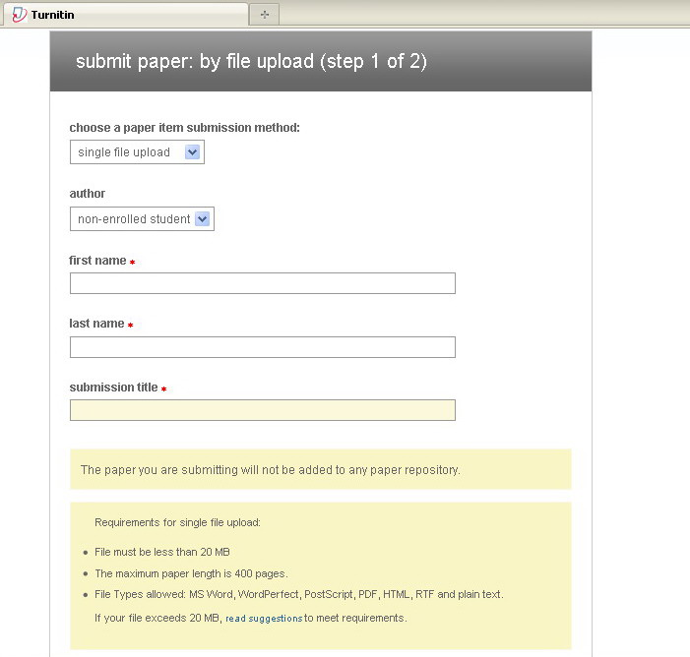
Plagiarism checking tools

Slide 29
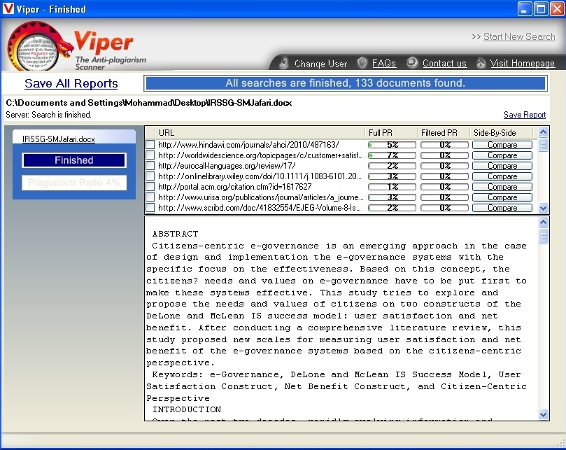

Slide 30
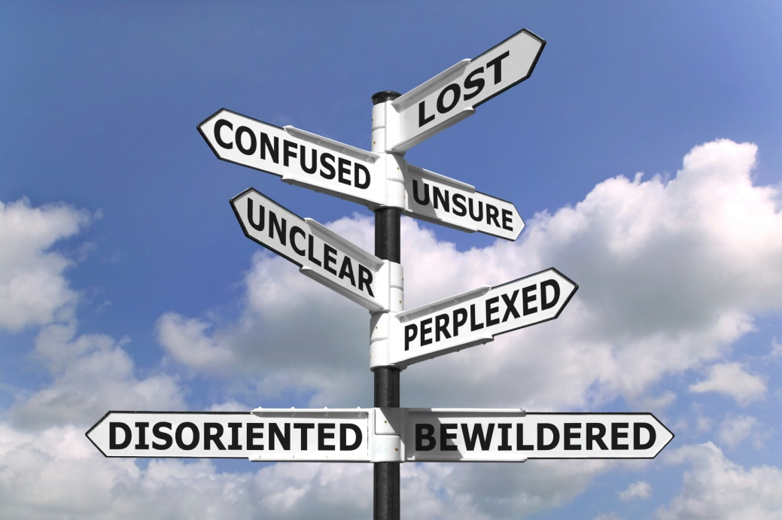

Q&A

Slide 31
References
http://science.thomsonreuters.sg/training
Research Tools Mind Map by Nader Ale Ebrahim
www.aleebrahim.com

Slide 32

Good luck
in your research
jafari76@gmail.com

